Slide 1


Slide 2
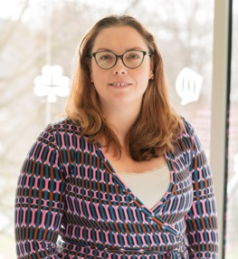
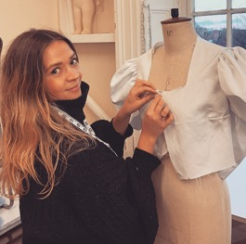
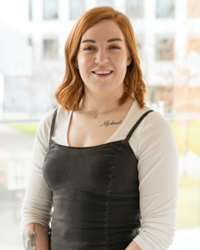
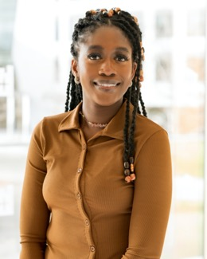
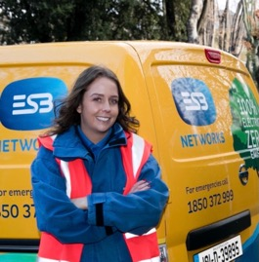
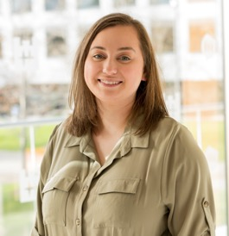
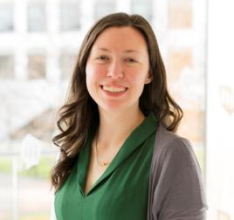
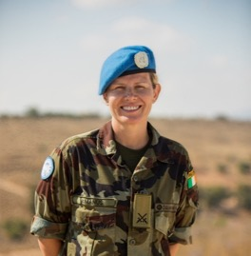
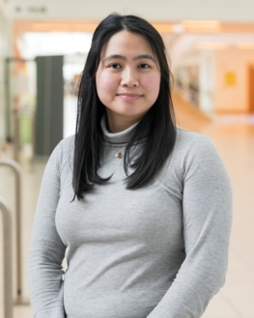
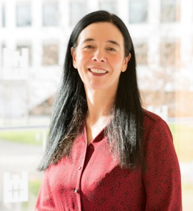
Cathy Fleming – Senior Medical
Physicist, St. Luke’s Hospital
Sharon Sweeney – Fashion Designer
Riana Roche –
Engineering Manager at Etsy
Anu Bode Favours – Computer
Science Undergraduate Student
Emily Clarke – Apprentice
Electrician, ESB
Dr Sarah Markham - Physics
Researcher at University of Limerick
Dr Lána Salmon - PhD Graduate
in Space Science
Sharon McManus - (Commandant)
Army Engineer Officer
Kyla Adanza – Software Development
Engineer at Amazon Web Services
Dr Sandra Collins - Director
of the National Library
Notes:
https://www.ucd.ie/mathstat/rolemodelsinpstem/
https://www.youtube.com/channel/UCYrh8Eh848_Ljzfx5BXiE9A

Slide 3



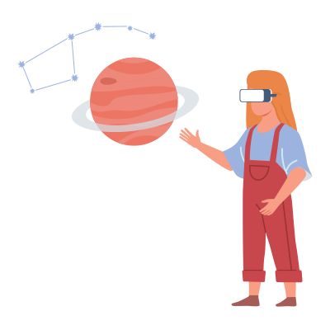
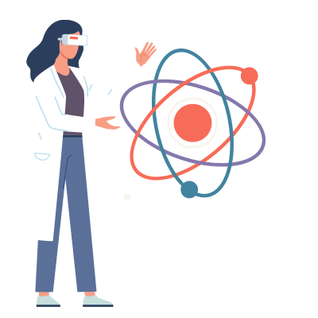
Better solutions to global challenges
More innovators with diverse backgrounds
More girls choose studies in STEM subjects
More role
models for girls
More
women
in STEM
Notes:
UNESCO Cracking the Code

Slide 4
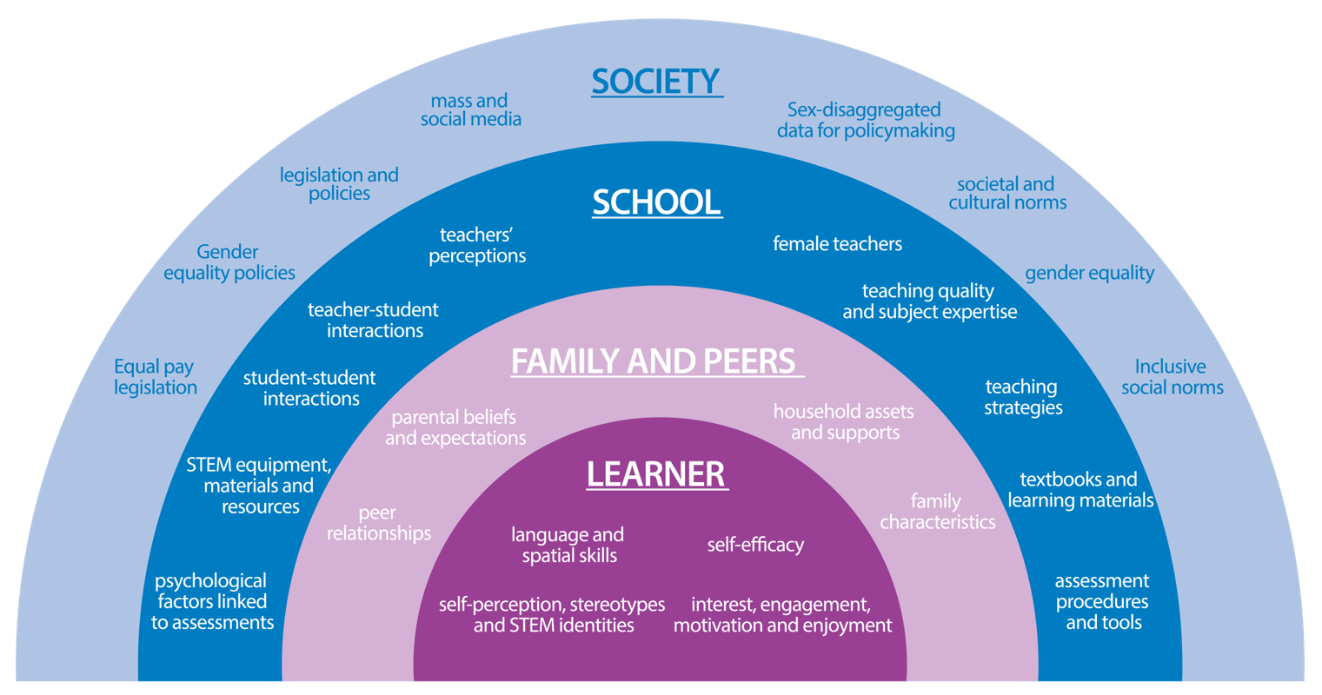
UNESCO Framework
(UNESCO, 2017)
Notes:
UNESCO Ecological Framework of factors influencing women and girls in science

Slide 5
Share air time equitably
Guidelines for Conduct
During Discussion
Make sure everyone feels safe
Value differences
Discomfort is okay
Own your impact
Argue using evidence
Notes:
Download poster at STEPUPphysics.org Introduce guidelines (Critical lesson component): Introduce these guidelines to students (or refer to your class conduct rules if you have already established them):
• Share air time equitably. Know yourself, balance your listening and talking.
• Value differences. Remember that your perspective is not the only one.
• Argue using evidence. Back what you have to say with data.
• Make sure everyone feels safe. Safe is not the same as comfortable.
• Discomfort is OK. Identify your learning edge and push it.
• Own your impact. Your intentions may not be the same as your impact.

Slide 6
STEM / pSTEM / STEAM / STEMM / STREAM
Notes:
Prompt 1
What does the acronym STEM stand for?
What does the acronym pSTEM stand for?
What do the acronyms of STEAM and STEMM represent and why are these acronyms useful (or not)?

Slide 7
pSTEM
Mathematics based science subjects such as physics,
mathematics, engineering and computer science

Slide 8
What are potential
careers in STEM
and/or pSTEM?

Slide 9
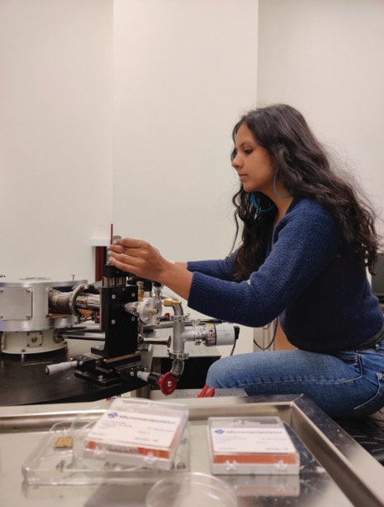
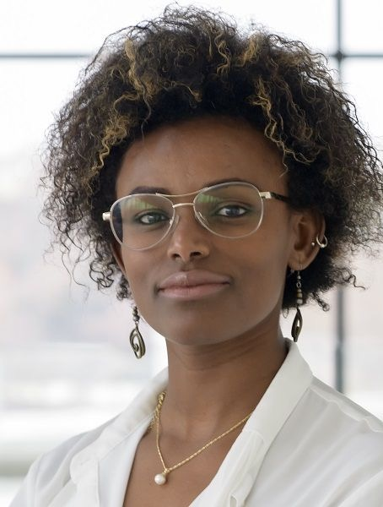
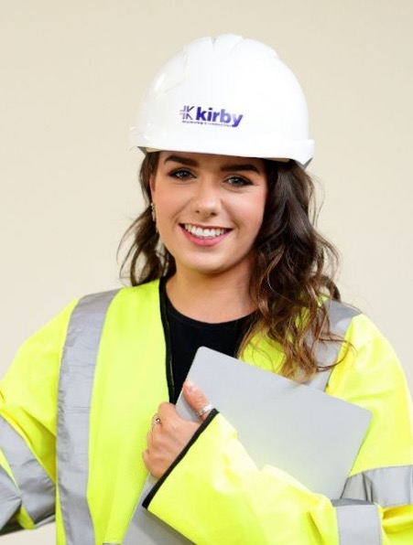
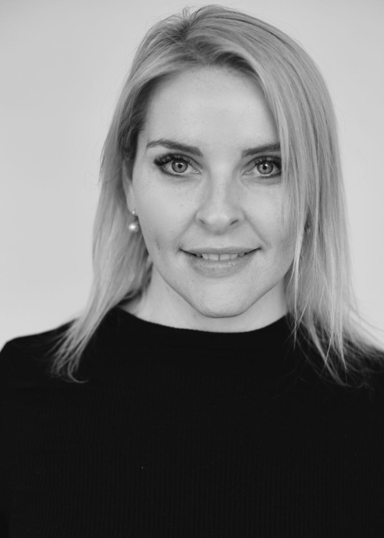
What are potential
careers in STEM
and/or pSTEM?
Notes:
Dr Yashaswi Nalawade (Astrophysicist working at Intel), Abeba Birhane (Cognitive Science with Computer Science PhD researcher)
Eve Brennan (Civil Engineer with Kirby Group), Caoimhe Durnin (Mathematics graduate and Global Head of Capital and Liquidity Risk at HSBC)

Slide 10
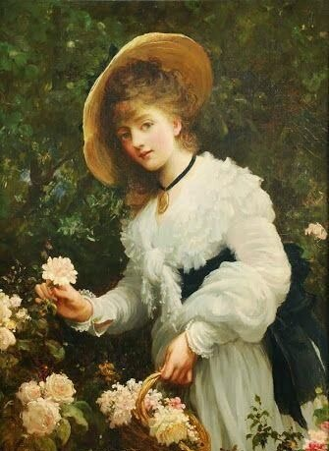
Why might more women do Biology & Chemistry than pSTEM subjects?
Middle-class women began to receive formal education in the 18th and 19th centuries.
Subjects like botany were thought likely to appeal to women with its associations to flower collecting and sketching.
Notes:
Image: “'Gathering Flowers' Sir Samuel Luke Fildes”

Slide 11
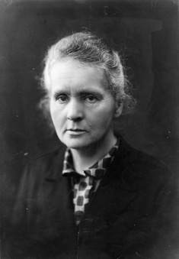
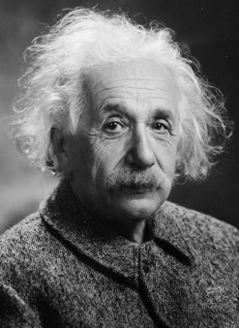
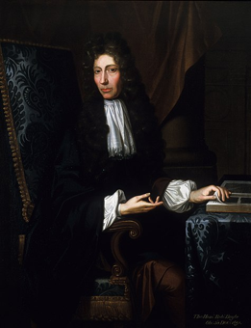
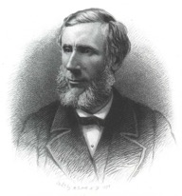
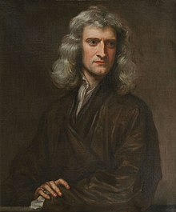
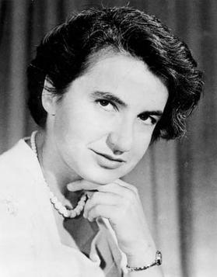
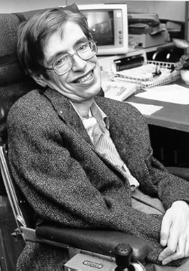
Can you think of some well-known scientists?
Notes:
Some well-known scientists: Newton, Einstein, Stephen Hawking, Robert Boyle, John Tyndall, Rosalind Franklin, Marie Curie.
Often those we think of are men, who are most often depicted in school textbooks.

Slide 12
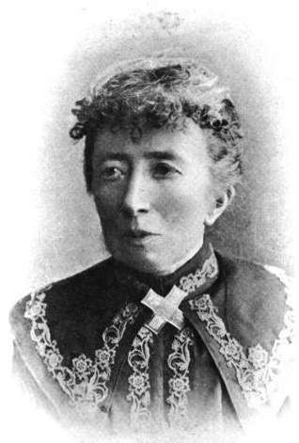
Were women interested in other science subjects?
Women were interested and successful in other subjects but were restricted in how they could share their findings and ideas, since ‘science’ was generally restricted to presentations in gentlemen’s clubs
Agnes Clerke, an Irish woman from Skibbereen in Co. Cork, wrote a seminal book on the ‘Popular History of Astronomy’ in 1885 but is rarely remembered for her work
Notes:
Prompt 1: https://www.schoolsobservatory.org/learn/history/biographies/agnes-clerke
Agnes Mary Clerke Medal of the Royal Astronomical Society Note https://ras.ac.uk/awards-and-grants/agnes-mary-clerke-medal-historical-research-ag

Slide 13
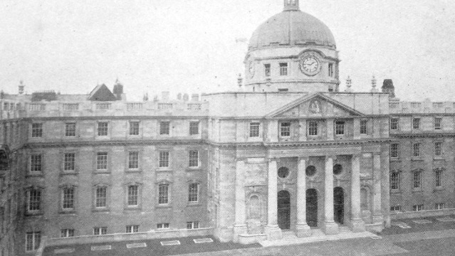
Royal College of Science for Ireland
First higher education college in Ireland or Britain to admit women to courses, laboratories and exams
Government Buildings
Notes:
Prompt 1: Royal College of Science for Ireland, now Government buildings still with statues of Boyle and Hamilton at the main entrance.

Slide 14
Royal College of Science for Ireland
Matilda Coneys, 1867, was the first woman to be permitted to join courses in pure Mathematics and won first overall prize for her examination results.
Government Buildings
Notes:
For further information read ‘Labcoats and Lace’ (reference in accompanying Teacher Handbook)

Slide 15
Who belongs in the fields of pSTEM?
What contributes to a person being successful in the fields of pSTEM?
Notes:
Prompt 2

Slide 16
Influences affecting college course selection
FUNCTIONAL
INFLUENCES
HUMAN
INFLUENCES
62%
Felt I would fit in
56%
Career Prospects
(SFI, 2017)
Notes:
Prompt 2

Slide 17
Sense of belonging with mathematics
Student’s sense of belonging in mathematics is a significant predictor of their intention to pursue mathematics in future.
Even when controlling for their opinion of their mathematical ability.
A stronger sense of belonging led to less feelings of anxiety and more belief in the utility of maths and their ability in it
A growth mindset correlated with a greater sense of belonging for female students, but not for male students
Notes:
Prompt 2

Slide 18
Fixed versus Growth mindset
Notes:
Prompt 2: Introduce students to the concept of a fixed mindset (entity theory – a belief that you are born with a fixed amount of intelligence in a subject) as opposed to grow mindset (incremental theory for those who hold the concept that ability is malleable).

Slide 19

Giving praise for effort
When children aged 1-3 are praised for effort instead of their achievement, it impacts their mindsets later in their life at ages 7-8
Children praised for effort are more likely to:
Believe that you build on learning
Prefer challenging tasks
Attribute success and failure to effort
Praising for effort:
“you must have tried hard”,
“good job drawing”
Praising for achievement:
“You’re so smart”,
“good boy/girl”
Notes:
Prompt 2: In this study from Gunderston and colleagues visited 53 children and caregivers every 4 months, from the age of 14 months ,for three years. The type of praise children received was analysed. Children were given questionnaires at the ages of 7-8.

Slide 20
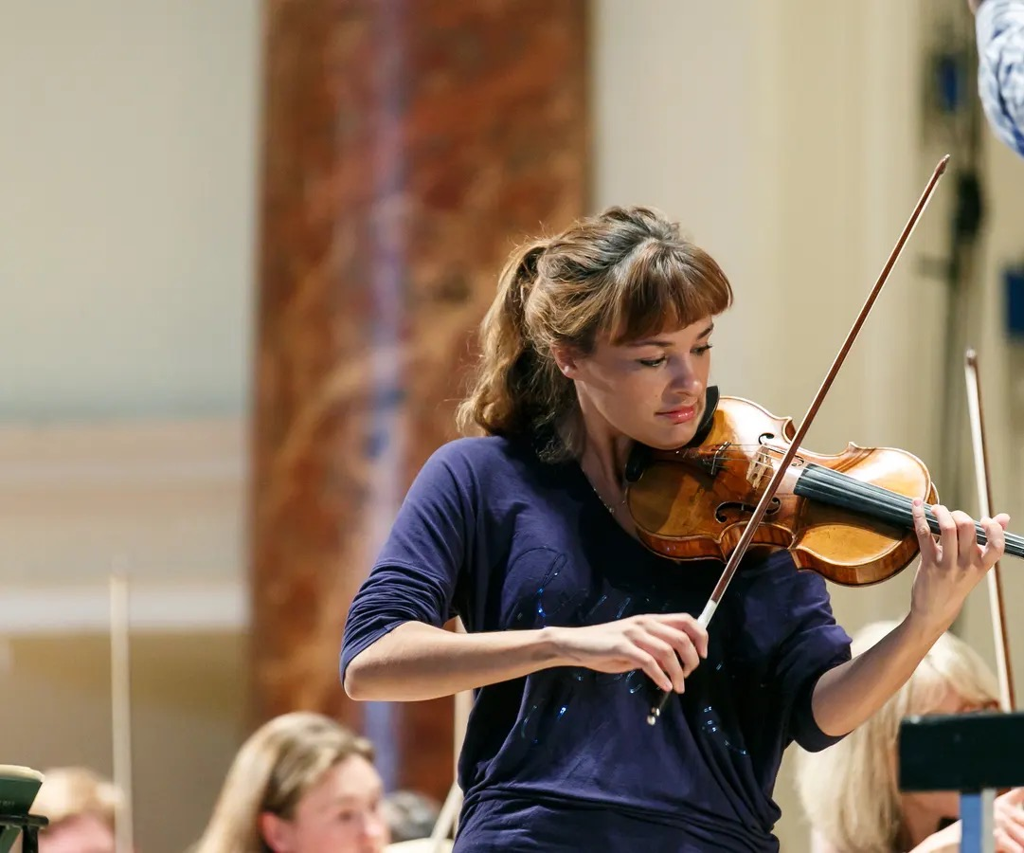
Unconscious Bias
Why were there so few female violin leads (5%) in orchestras worldwide?
Research by two economists, Claudia Goldin and Cecilia Rouse, conducted blind auditions where the violinist stayed behind the screen.
Female violinists’ chances of making it through the first round of auditions went up 50% and to the final rounds by 300%.
Notes:
Prompt 2: Nicola Benedetti - https://www.theguardian.com/music/2019/jun/15/nicola-benedetti-violinist-wynton-marsalis

Slide 21
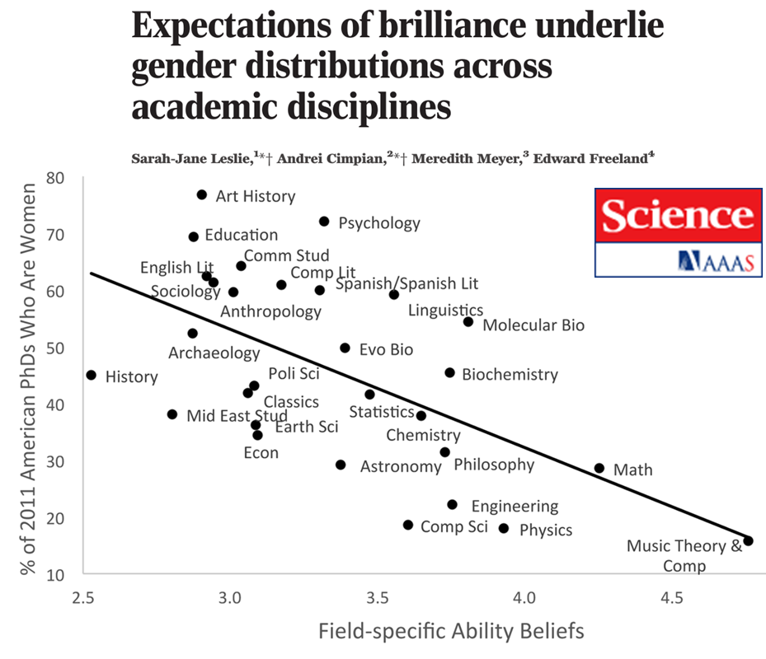
An effect of unconscious bias
The more a subject is associated with perceived intellectual ability, i.e. a fixed mindset, the lower the percentage of students in that field who are women.
Notes:
Prompt 2: https://www.science.org/doi/10.1126/science.1261375

Slide 22
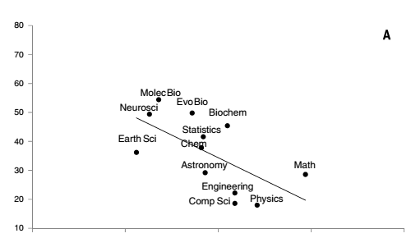
Expectations of brilliance (STEM)
Percentage of U.S PhDs who are female
Field-specific ability beliefs
Leslie et al. (2015)
Notes:
Prompt 2: https://www.science.org/doi/10.1126/science.1261375

Slide 23
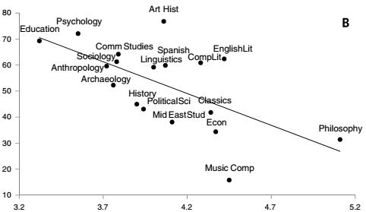
Expectations of brilliance
Percentage of U.S PhDs who are female
Field-specific ability beliefs
(higher numbers indicate greater emphasis on brilliance)
Leslie et al. (2015)
Notes:
Prompt 2: https://www.science.org/doi/10.1126/science.1261375

Slide 24
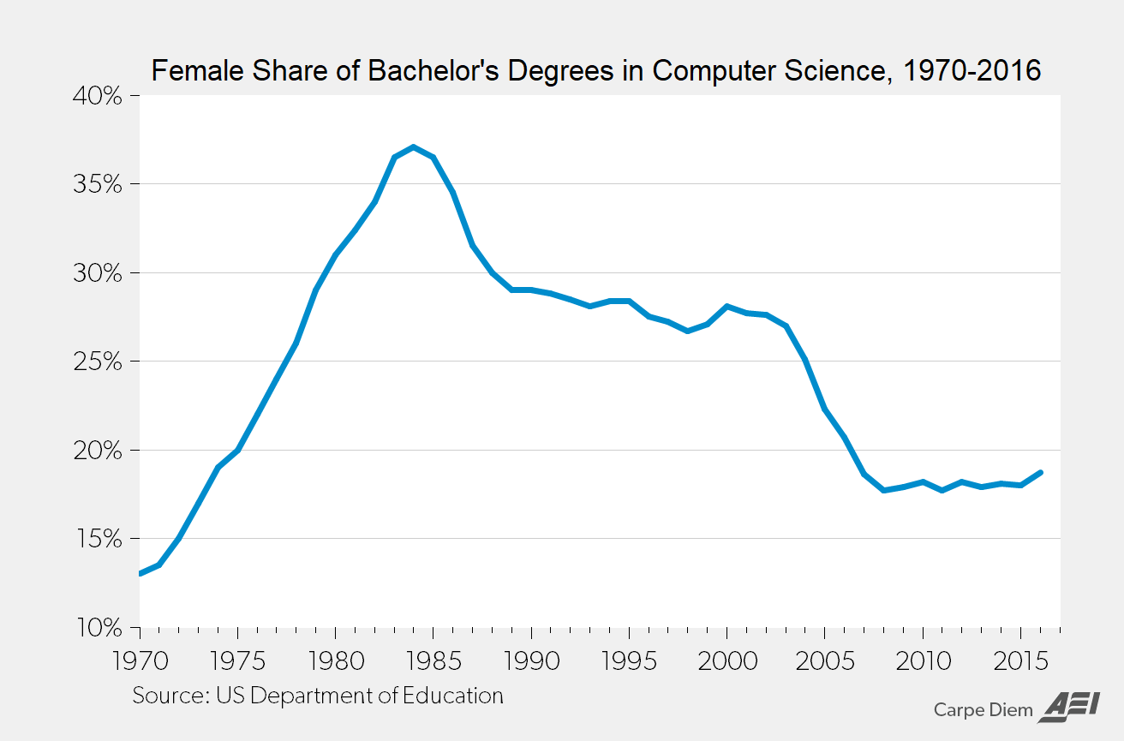
Why might we see a dip in the 1980’s?
Notes:
https://www.aei.org/carpe-diem/chart-of-the-day-the-declining-female-share-of-computer-science-degrees-from-28-to-18/
Dip potentially due to the marketing of playstations etc. to boys only.

Slide 25
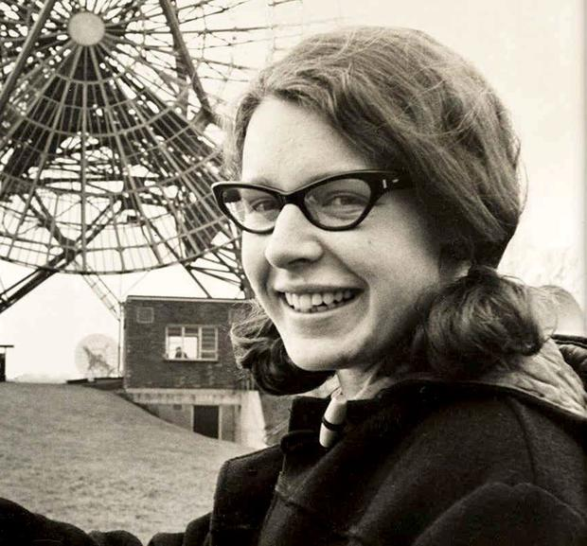
Matilde Effect
Jocelyn Bell Burnell
1943 –
Discovered Pulsars (a type of neutron star) but was not mentioned in the Nobel Prize her supervisor received for the discovery
Notes:
https://www.iop.org/about/support-grants/bell-burnell-fund/woman-behind-fund#gref

Slide 26
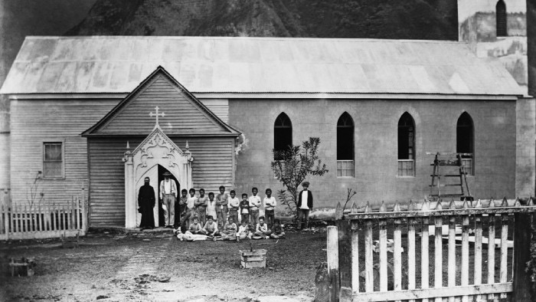
Matilde Effect
Alice Ball
Found the cure for leprosy, but the man she worked with got the credit
Notes:
https://medium.com/s/the-matilda-effect/alice-ball-matilda-effect-6b5fb64c74d6

Slide 27
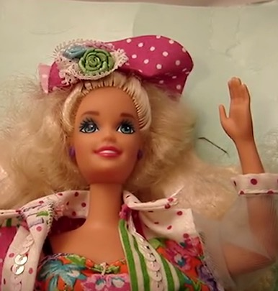

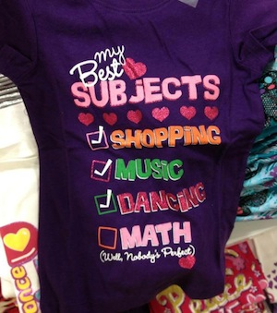
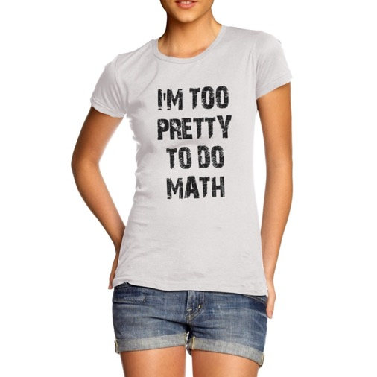
Cultural messages surrounding young women and mathematics
“Math class is tough! Party dresses are fun”
Notes:
What is unconscious bias and how does it manifest? For example: if you go to a toy store what are the toys typically indicated for boys and for girls?
There was a ‘Teen Talk Barbie’ released in 1992 that said “Math class is tough! Party dresses are fun!) - https://americaniconstemeple.wordpress.com/2019/04/05/math-class-is-tough/

Slide 28
Cultural messages around young women and mathematics in Ireland
Notes:
These exams, labelled ‘for girls only’ were given until the 1950s, likely having a generational cultural impact on the messages around ability in mathematics based on gender. It was far less likely that Higher Level mathematics be taught in an all-girls school.
https://archive.maths.nuim.ie/staff/dmalone/StateExamPapers/

Slide 29
Who did take Higher Level Mathematics?
MALE
FEMALE
1932
1940s
1952
1991
21%
26%
16%
3%
<2%
1%
8.2%
Notes:
Perhaps students could interview neighbours or relative about their experiences of learning mathematics.

Slide 30
Are there still biases around what girls should be taught?
Notes:
Teachers may wish to reference STEM Education report (2016) for further discussion around this (see the Teacher Handbook for reference).

Slide 31
Numbers sitting physics, chemistry and biology by gender (Leaving Certificate 2013)
Numbers taking Leaving Certificate Technology subjects
Notes:
(Department of Education, 2016)

Slide 32

Why might people decide to go into a career in STEM?
What might be some barriers which prevent people from going into STEM careers?
Do you think stereotypes have any influence on what career you would or would not want to pursue?
Notes:
Prompt 3: Why might people decide to go into a career in STEM?
• What might be some barriers which prevent people from going into STEM careers?
• Do you think stereotypes have any influence on what career you would or would not want to pursue?
• What is unconscious bias and how does it manifest? For example: if you go to a toy store what are the toys typically indicated for boys and for girls?
• Why might we need particular days like the International Day for Women & Girls in Science (February 11th)?
• How might we all support diversity and inclusion better in our everyday lives?

Slide 33


11 February
International Day of Women and Girls in Science
Notes:
Prompt 3: Why might we need particular days like the International Day for Women & Girls in Science (February 11th)? https://en.unesco.org/commemorations/womenandgirlinscienceday

Slide 34
What surprised you most from watching the video(s)?
What were the stereotypes you may have had of someone working in this field before watching the video?
What advice did you find most helpful from the role model?
What struck you most about the background of the role model?
What do you have in common or that is different to the role models you saw?
Keep in mind while watching the videos

Slide 35
Cathy Fleming – Senior Medical
Physicist, St. Luke’s Hospital
Sharon Sweeney – Fashion Designer
Riana Roche –
Engineering Manager at Etsy
Anu Bode Favours – Computer
Science Undergraduate Student
Emily Clarke – Apprentice
Electrician, ESB
Dr Sarah Markham - Physics
Researcher at University of Limerick
Dr Lána Salmon - PhD Graduate
in Space Science
Sharon McManus - (Commandant)
Army Engineer Officer
Kyla Adanza – Software Development
Engineer at Amazon Web Services
Dr Sandra Collins - Director
of the National Library
Notes:
https://www.ucd.ie/mathstat/rolemodelsinpstem/
https://www.youtube.com/channel/UCYrh8Eh848_Ljzfx5BXiE9A

Slide 36
FOLLOW UP ACTIVITIES
AND DISCUSSIONS

Slide 37
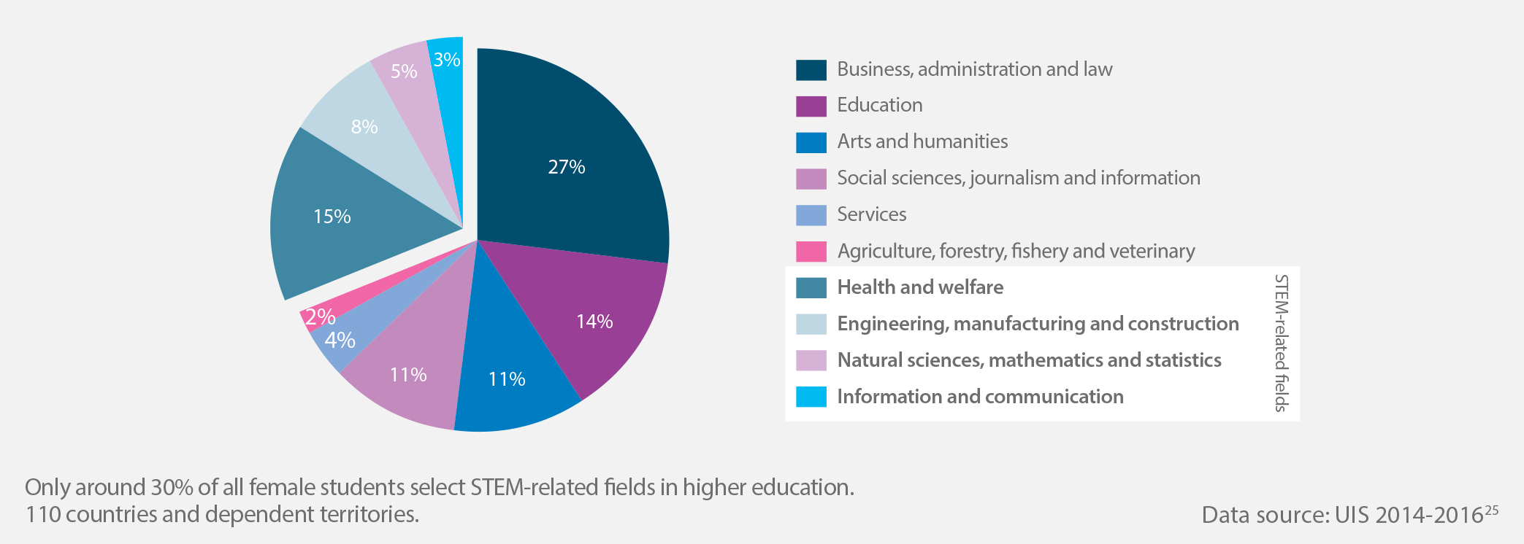
Trends across the world
Distribution of female students enrolled in higher education, by field of study, world average
(UNESCO, 2017)

Slide 38
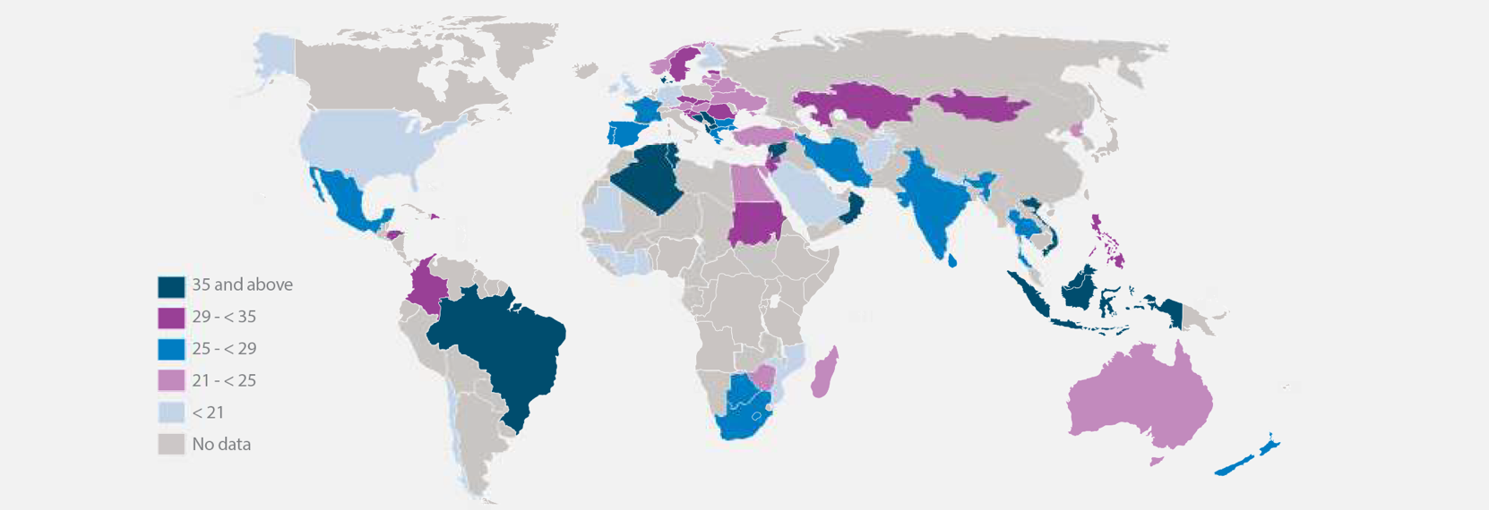
Trends across the world
Percentage of female students enrolled in engineering, manufacturing and construction programmes in higher education in different parts of the world
(UNESCO, 2017)

Slide 39
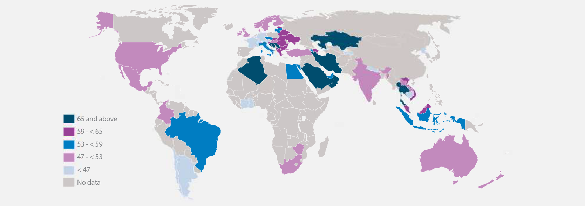
Trends across the world
Percentage of female students enrolled in natural science, mathematics and statistics programmes in higher education in different parts of the world
(UNESCO, 2017)

Slide 40
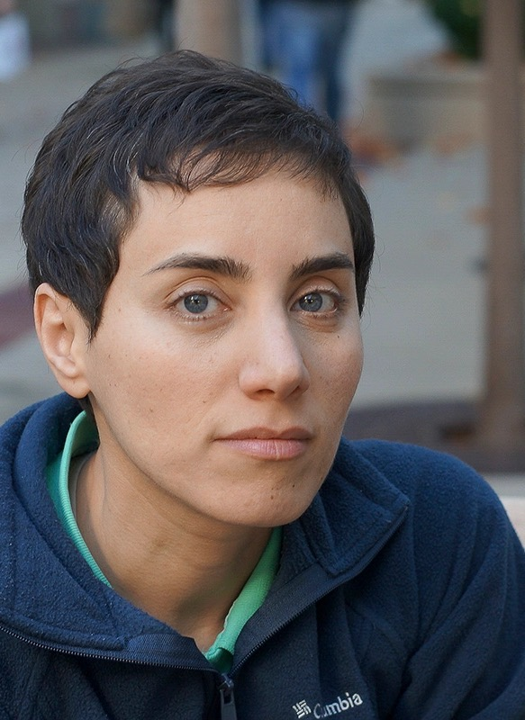
Gender-Equality Paradox
From these two diagrams, there seems to be a paradox that in countries where we expect more gender equality, where we expect girls and women to have more educational opportunities, less women are participating in STEM.
It may be interesting to consider the cultural messages and stereotypes that exist in other countries.
As an example, in the previous slide we saw large numbers of women choosing to study Mathematics in Iran. Maryam Mirzakhani, an Iranian professor of Mathematics, won the Fields Medal in 2014 and is, so far, the only woman to do so.
Notes:
https://www.google.com/url?sa=i&url=https%3A%2F%2Fnews.stanford.edu%2F2017%2F07%2F15%2Fmaryam-mirzakhani-stanford-mathematician-and-fields-medal-winner-dies%2F&psig=AOvVaw1W9I3LA34DD-Ct6L1MqNLF&ust=1646252757130000&source=images&cd=vfe&ved=0CAsQjRxqFwoTCJCGoMnfpfYCFQAAAAAdAAAAABAD

Slide 41
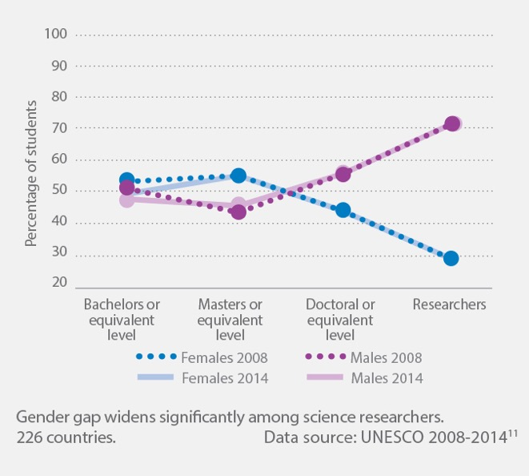
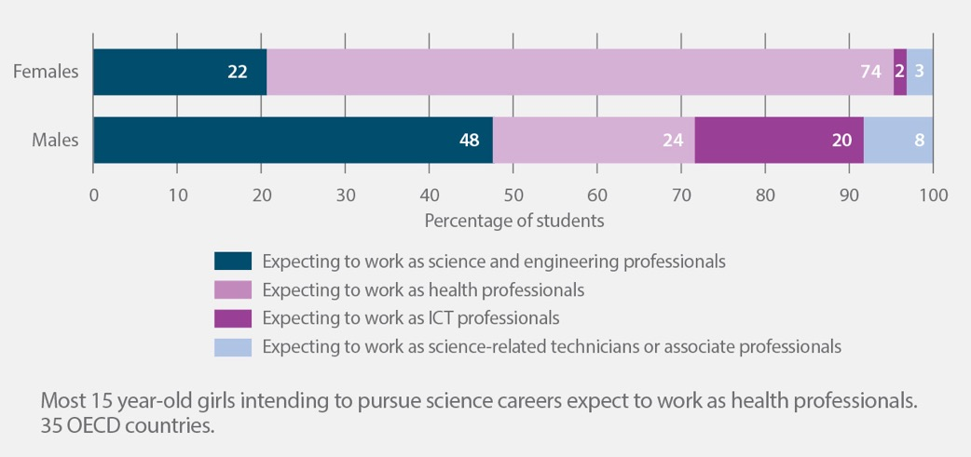
Trends across the world
Proportion of women and men in higher education and research, world average
Student expectations on science careers, by sub-field of study, out of those who choose science careers, 15-year olds
(UNESCO, 2017)

Slide 42
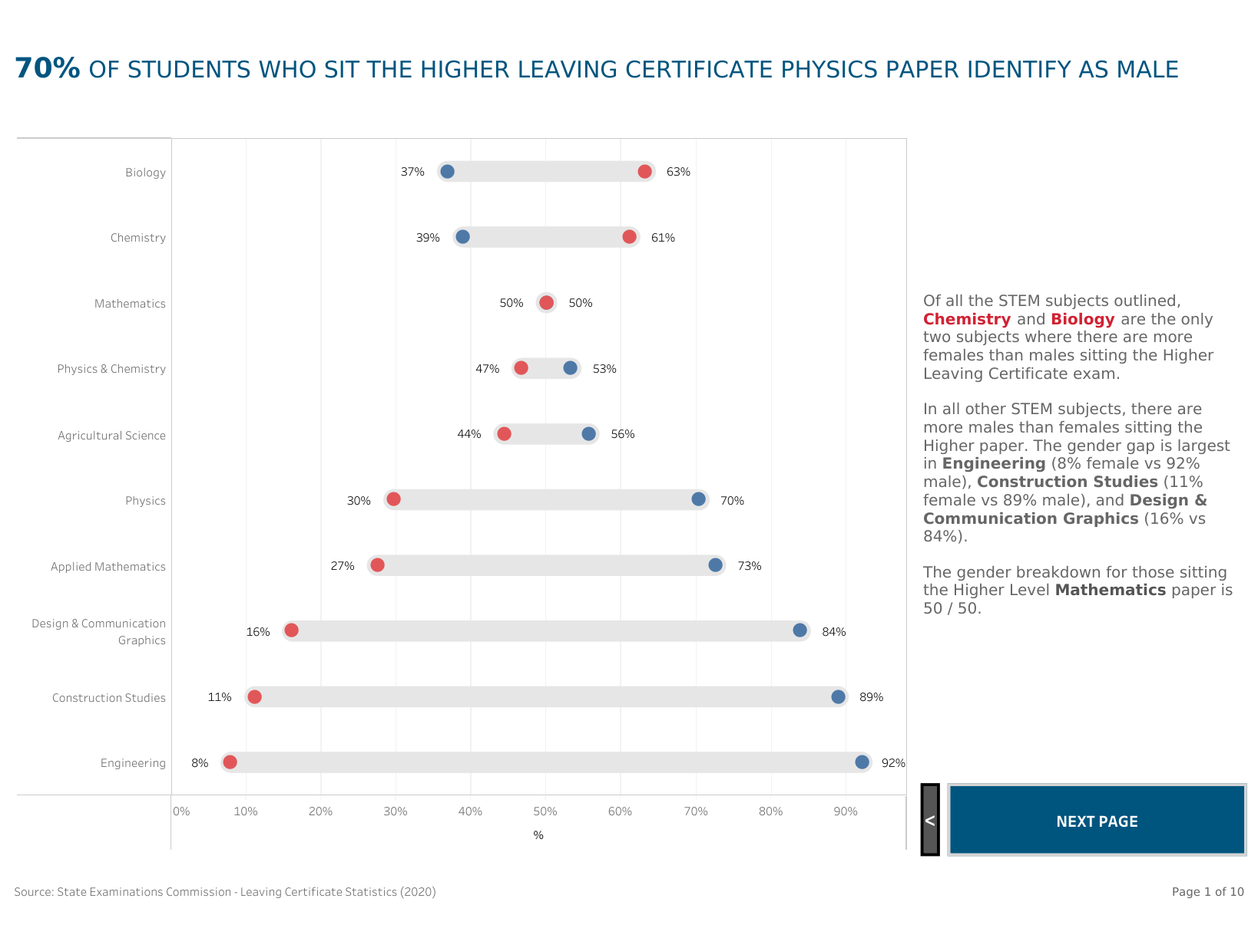
Notes:
https://hea.ie/statistics/data-for-download-and-visualisations/females-in-stem/

Slide 43
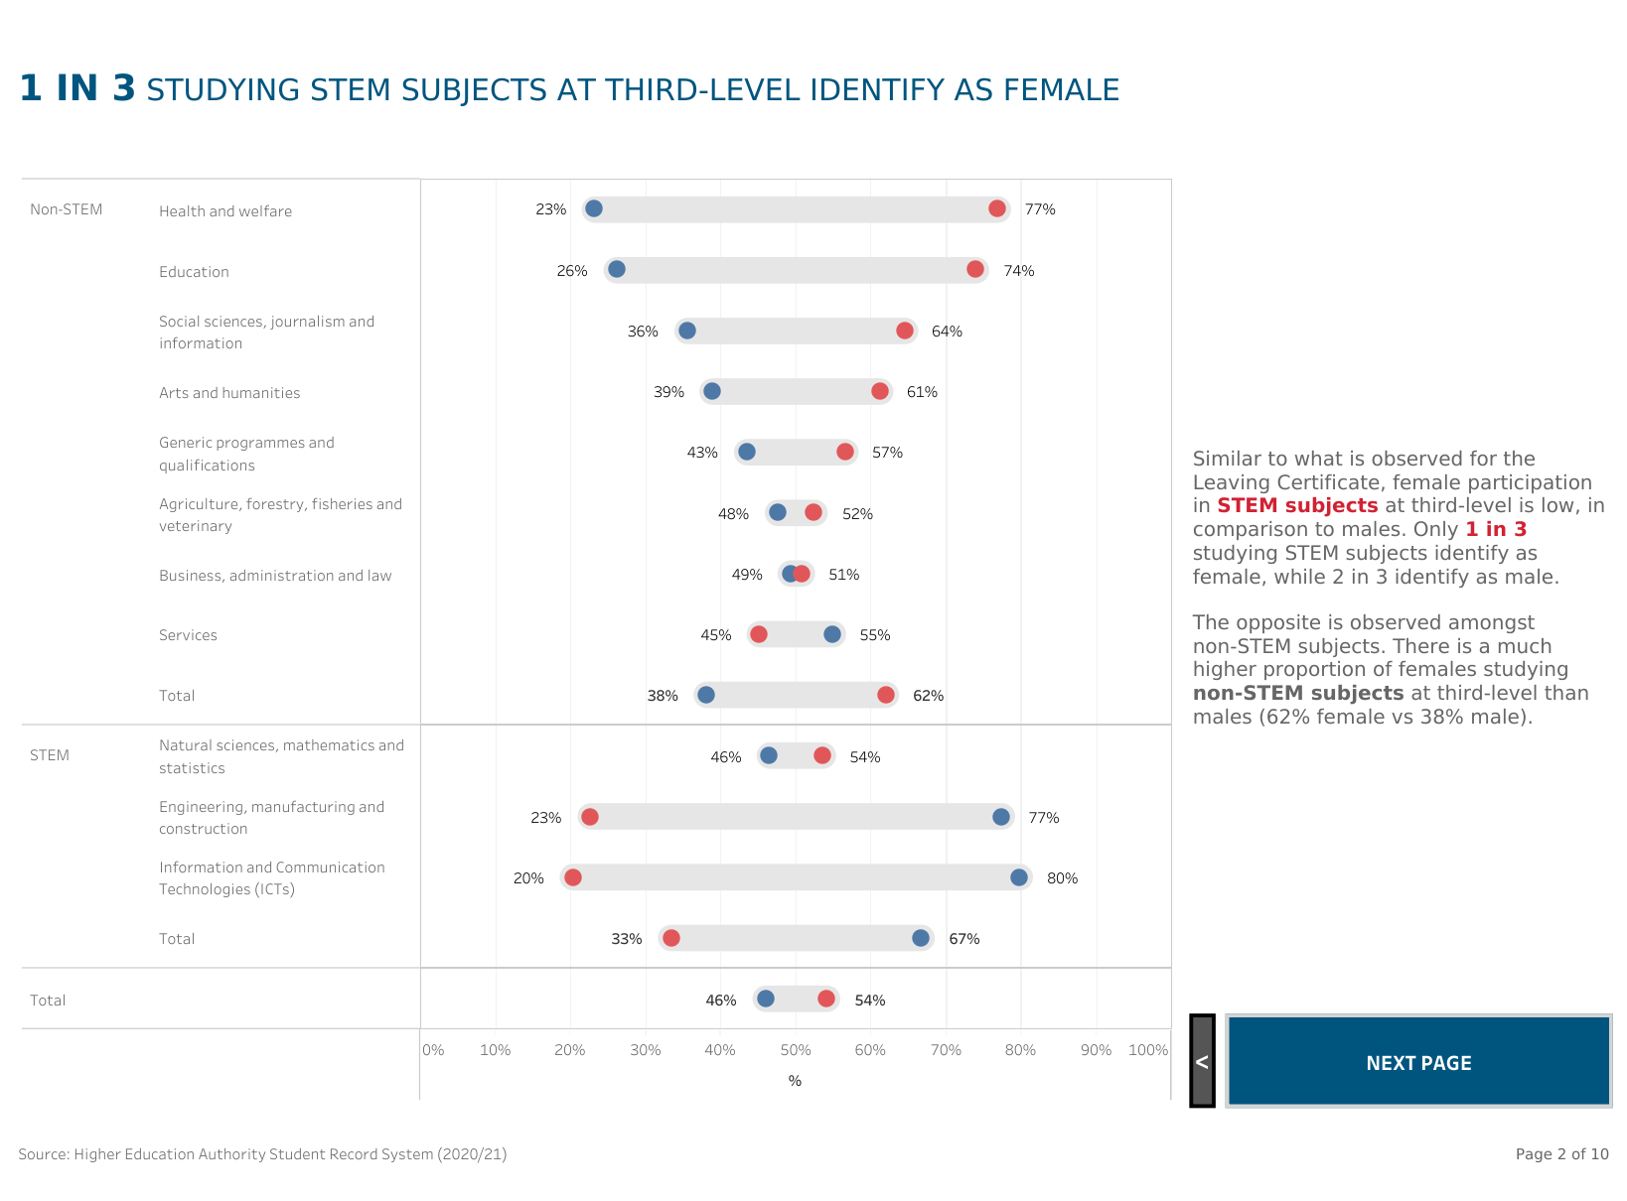
Notes:
https://hea.ie/statistics/data-for-download-and-visualisations/females-in-stem/

Slide 44
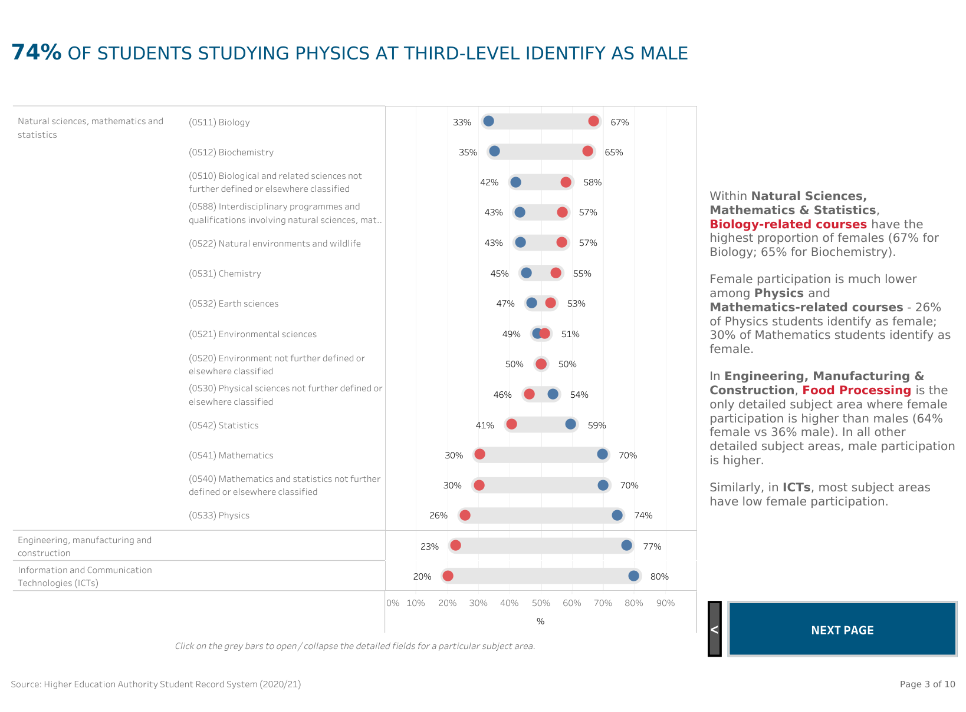
Notes:
https://hea.ie/statistics/data-for-download-and-visualisations/females-in-stem/

Slide 45
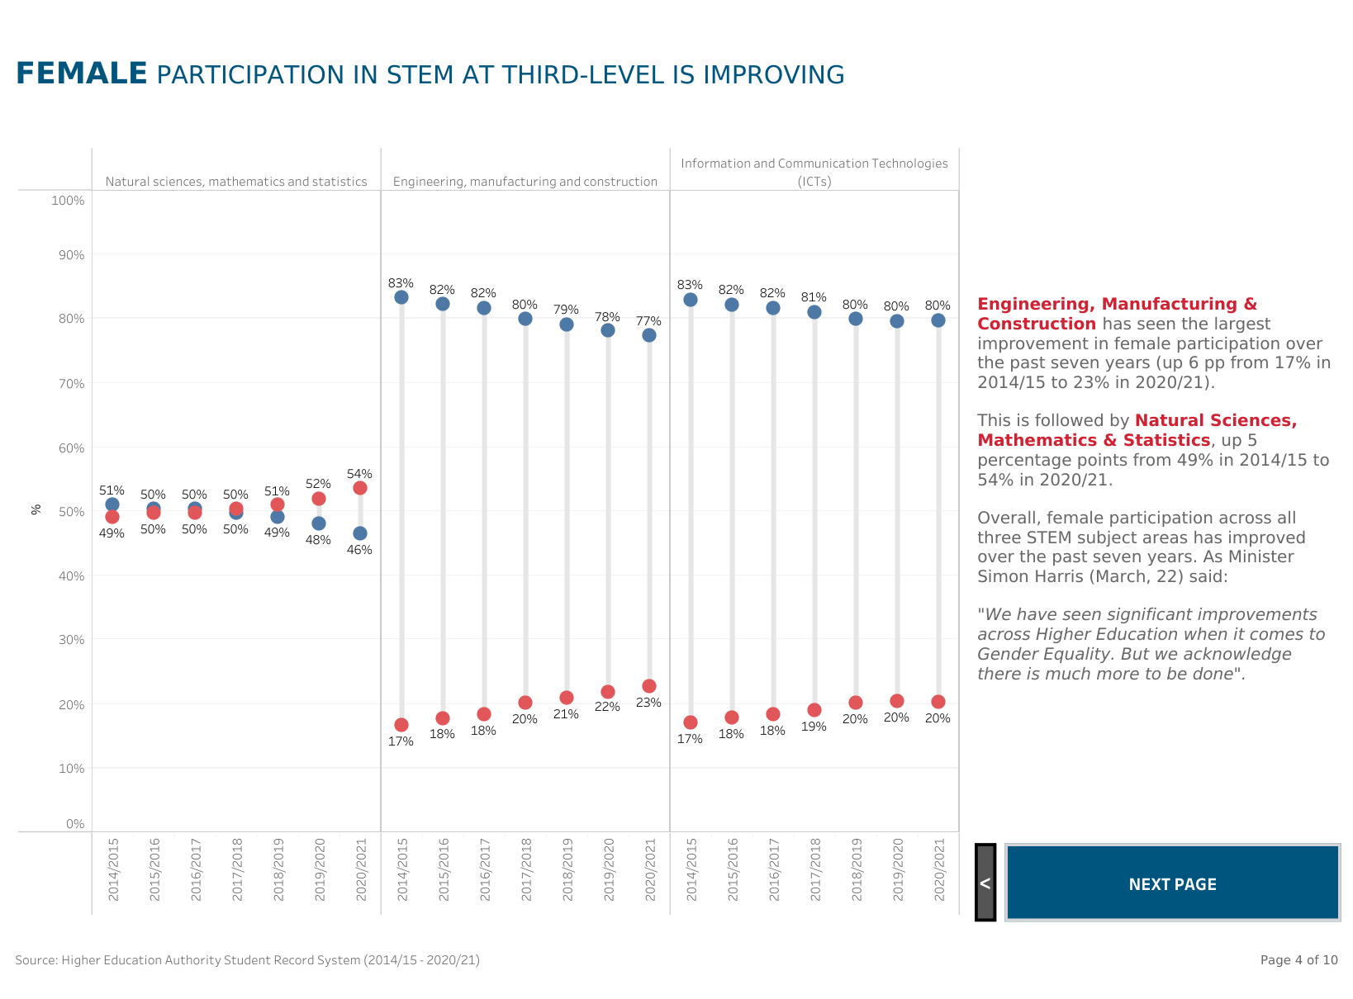
Notes:
https://hea.ie/statistics/data-for-download-and-visualisations/females-in-stem/

Slide 46

Leaving Cert Results
Examine how well girls do in Physics, Applied Maths, Engineering etc. in the annual Leaving Certificate results. How does this compare to Biology and Chemistry?
Notes:
Statistics on all of the exam results can be found and downloaded on examinations.ie

Slide 47
Values Affirmation Exercise
Research has demonstrated that in undergraduate physics classes, students improved their academic results simply by spending 15 minutes writing about the values that matter to them most.
Why not spend 15 minutes on the following activity – it may impact positively on your next exam result!
Choose two or three values that are most important to you and write about why they are important to you. You may also wish to consider how you try to live up to these values.
You can use the following list to choose the values most important to you or can identify your own:
being good at art; creativity; relationships with family and friends; government or politics; independence; learning and gaining knowledge; athletic ability; belonging to a social group (such as your community, racial group, or club); music; career; spiritual or religious values; sense of humour.

Slide 48
Find a STEM or pSTEM role model from your local school, community, family, or area to do a project on:
You may find inspiration online, for example on the WITS Ireland website
You might like to ask these people the same questions that we asked our role models for the videos (see ‘Interview Questions for a Role Model’ section of the Teacher Handbook)
Your project may be a video, podcast, presentation or poster – depending on what works best for your class
Notes:
https://www.ucd.ie/mathstat/rolemodelsinpstem/

Slide 49
Or…
Find an historical role model in STEM/pSTEM to do a project on:
You may like to focus on Irish women only (e.g. Kay McNulty)
You may wish to consider women from movies such as ‘Hidden Heroes’ or those from books such as ‘Power in Mathematics’
Why not visit the local library and see who you might find there?

Slide 50
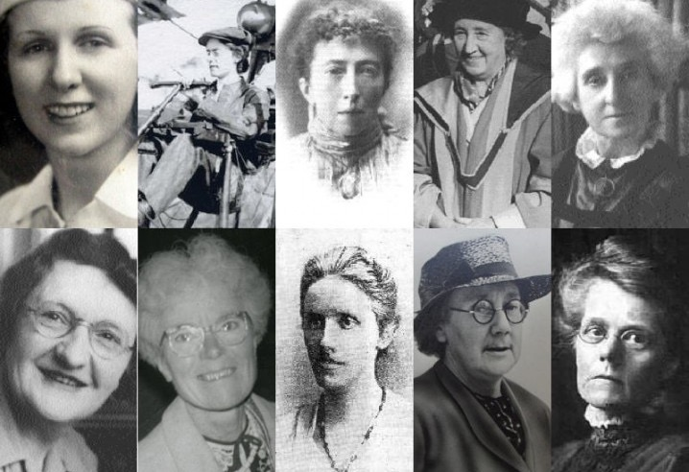
Pioneering Irish Women in Science
Kay McNulty
Lilian Bland
Agnes Clerke
Phyllis Clinch
Margaret Lindsay Huggins
Cynthia Longfield
Kathleen Lonsdale
Annie Maunder
Dorothy Stopford Price
Alicia Boole Stott
Notes:
Irish women mentioned in the ‘Labcoats and Lace’ book

Slide 51
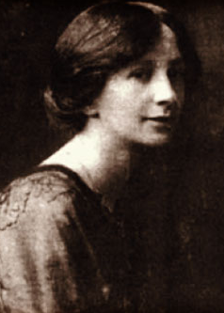
Alice Perry
Europe’s first female engineering graduate
First-class honours degree, National University of Ireland, Galway
First female land surveyor in Ireland
Notes:
https://www.engineersireland.ie/Covid-19-information-base/alice-perry-the-galway-woman-who-became-europes-first-engineering-graduate

Slide 52
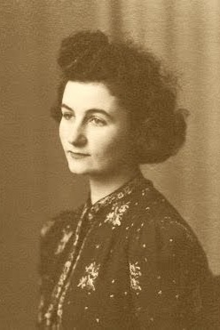
Sheila Tinney
First Irish woman to be awarded a PhD in Mathematics
PhD with Nobel laureate Max Born, 1945
Fellowship to the Institute for Advanced Study at Princeton
“among the best equipped and most successful of the younger generation of theoretical physicists in this country” Schrödinger
One of the first four women elected to membership of the Royal Irish Academy, 1949
Lectured in UCD until 1978
Notes:
https://www.ucd.ie/newsandopinion/news/2018/august/30/conferencecelebratesdrsheilatinneyfirstirishwomanawardedphdinmathematics/

Slide 53




First women admitted to Royal Irish Academy, 1949
Sheila Tinney
Françoise Henry
Phyllis Clinch
Eleanor Knott
Notes:
https://www.siliconrepublic.com/innovation/women-on-walls-accenture-royal-irish-academy
Royal Irish Academy and history of women: “Better without the ladies” William Rowan Hamilton
Sheila Tinney (1918 – 2010) A pioneering academic in mathematical physics, Sheila Tinney was described by Nobel Laureate Erwin Schrödinger as ‘among the best equipped and most successful of the younger generation of physicists in this country’.
Françoise Henry (1902 – 1982) Françoise Henry was one of the most important twentieth-century historians of Irish art. She trained at the École du Louvre and the Sorbonne, establishing herself as an expert on very early forms of sculptural decoration, particularly in Early Christian Irish Art.
Phyllis Clinch (1901 – 1984) Award winning scientist Phyllis Clinch, was one of the greatest female inventors of her generation and world renowned for her innovative research into plant viruses.
Eleanor Knott (1886-1975) Eleanor Knott was a "pathbreaking" researcher of classical Irish literature. Having taught herself to read modern Irish, she went on to study old Irish at the School of Irish Learning in Dublin and won a scholarship to continue her studies in 1907.

Slide 54

Women on Walls – Royal Irish Academy
Notes:
Recipients of the European Research Council Starter Grants 2012 – 2015
Professor Emma Teeling (UCD) world authority on bat genetics. Professor Caitríona Lally (TCD) - principal investigator on a project focusing on developing a means of early diagnosis of degenerative cardiovascular diseases.
Professor Debra Laefer (UCD) - prevent damage to buildings above tunnel excavation, by developing a 3D modelling system that can predict what buildings are most likely to sustain damage during tunnelling.
Professor Lydia Lynch (Harvard Medical School moving to TCD) anti-tumour immune cell protects against obesity and the metabolic syndrome that leads to diabetes
Dr Maria McNamara (UCC) fossilization of colour in animals and has conducted ground-breaking work on the evolution of feathers in dinosaurs.
Professor Sarah McCormack (TCD) explores photovoltaic panels which convert solar energy into direct current electricity.
Professor Aoife McLysaght (TCD) one of Ireland’s leading geneticists and was on the team that analysed the initial sequence of the human genome in 2001.

Slide 55








Project Partners

Slide 56








Project Partners

